Slide 1




DIGITAL LITERACY
SKILLS
INTERMEDIATE USERS

Slide 2
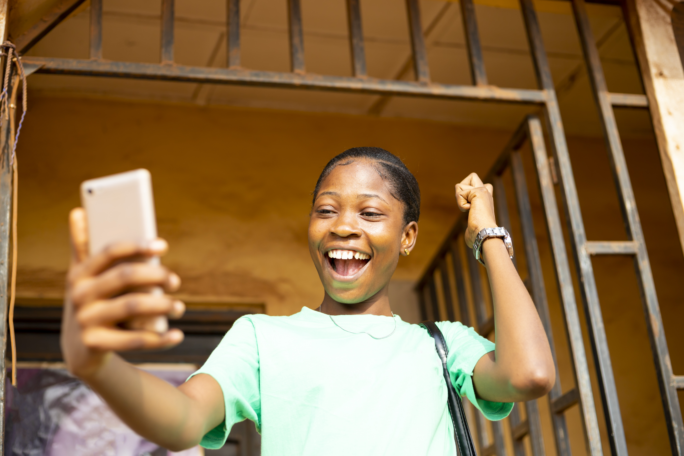
Module 4
Content

Slide 3

1
Unit 3: Copyright and licenses

Slide 4
Main concepts: IT, ICT, and Internet
Copyright ownership gives the owner exclusive rights to use the work, with some exceptions.
When a person creates an original work, fixed in a physical form (electronic or hardcopy), they automatically own copyright to the work, for example:
audiovisual works, such as TV programmes, films and online videos
sound recordings and musical compositions
written works, such as lectures, articles, books and musical compositions
visual works, such as paintings, posters and advertisements
video games and computer software
dramatic works, such as plays and musicals.

Slide 5
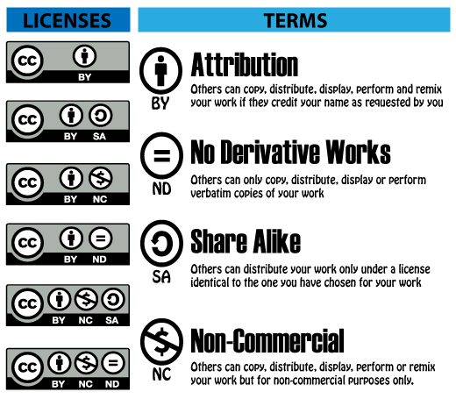
Using a copyright-protected work without infringing
It’s possible to use a copyright-protected work without breaking the owner’s copyright.
Some content owners make their work available for reuse with some limitations under a Creative Commons license.
There are six Creative Commons (CC) licenses.

Slide 6

Copyright law
Copyright law exists in all countries.
Work created in a country is subject to the copyright laws of that country and the copyright laws of the country in which it may be used.

Slide 7

Copyright law and the internet
The internet makes it very easy to copy other people’s work directly into your own document.
It’s illegal if you do not acknowledge the person who created it.
The creator is the owner of that content, so copying it and letting people think it is your own work is plagiarism, which is a form of theft.

Slide 8

Copyright law and the internet
This applies to all types of content, such as written content, images, videos, and audio recordings.
You can reuse any content you if:
you don’t sell it for profit
if you write a reference to the owner below it or next to it.

Slide 9

Online plagiarism checkers
Free plagiarism checker apps allow people to upload suspicious content for checking.
The checker compares the suspicious content with content in hundreds of similar or related documents.
It is very difficult to get past these checkers as they check and compare word for word and line by line.

Slide 10
Skills to practise
Reference content in your blog
In Unit 1, you created a blog. While writing content for your blog, you may use content that is copyrighted.
Read the guidelines in this website to make sure that you cite other sources correctly: https://makersaid.com/blog/how-to-cite-sources-in-a-blog/

Slide 11
All back covers should include
contact information of the section
producing the work.
© United Nations Children’s Fund (UNICEF) [month and year of publication]

